Slide 1


How to transfer files into Tango Core Model?
February 2017

Slide 2
Agenda
This document aims at describing each step to transfer files into Tango Core Model.
The new solution replaces FTP transfer

Slide 3
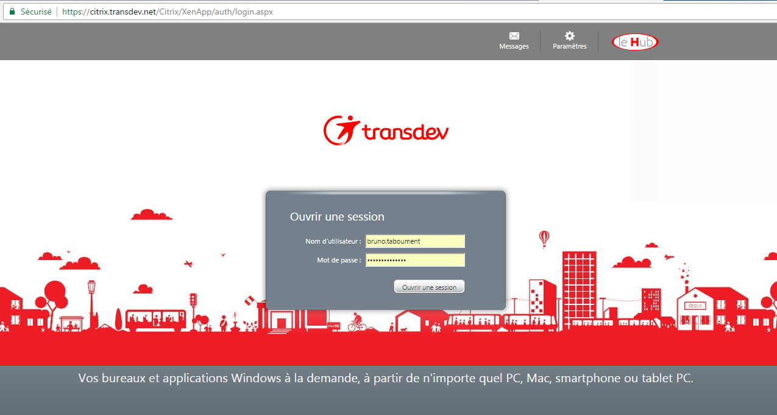
Step 1/6 : Connect to Citrix
Connect to https://citrix.transdev.net/
Enter your user and password

Slide 4
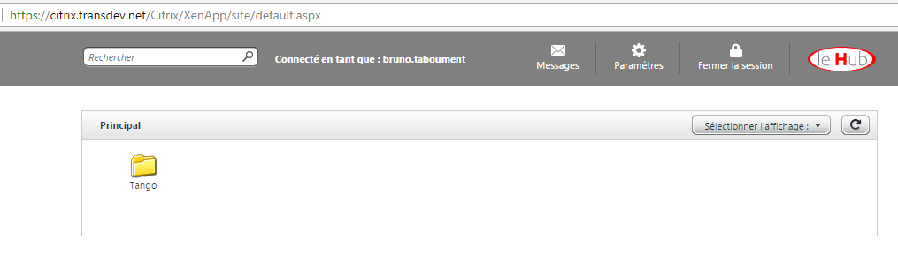
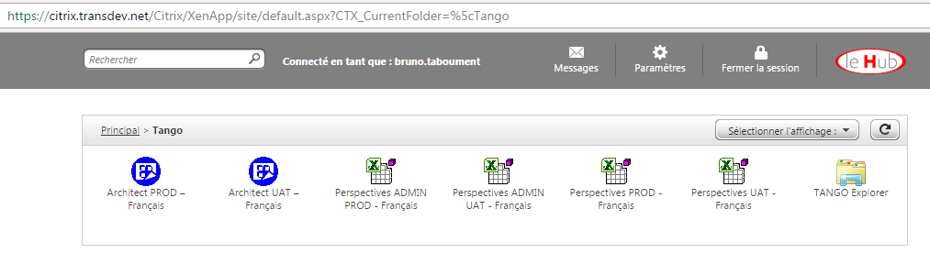
Step 2/6 : Open Citrix Server Explorer
Click on Tango directory
Click on TANGO Explorer
NB : Tango directory may not be the only icon into your Citrix Portal

Slide 5
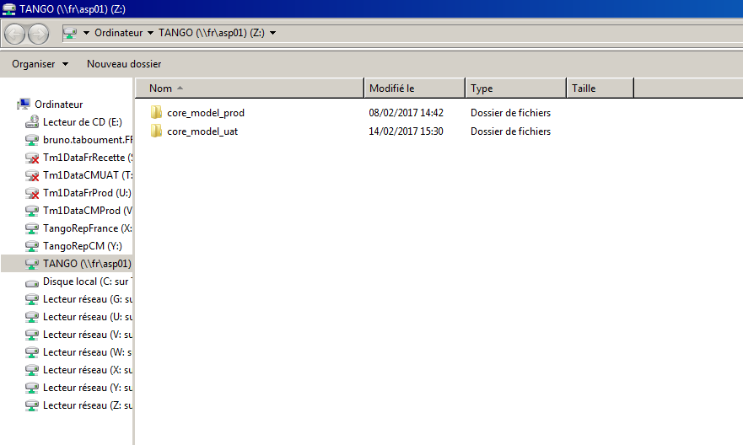
Step 3/6 : Open Citrix Server Explorer
Target directory for Production and UAT (tests) environnement where the users will upload the files
Target directory
Your network drives and your computer’s directories

Slide 6
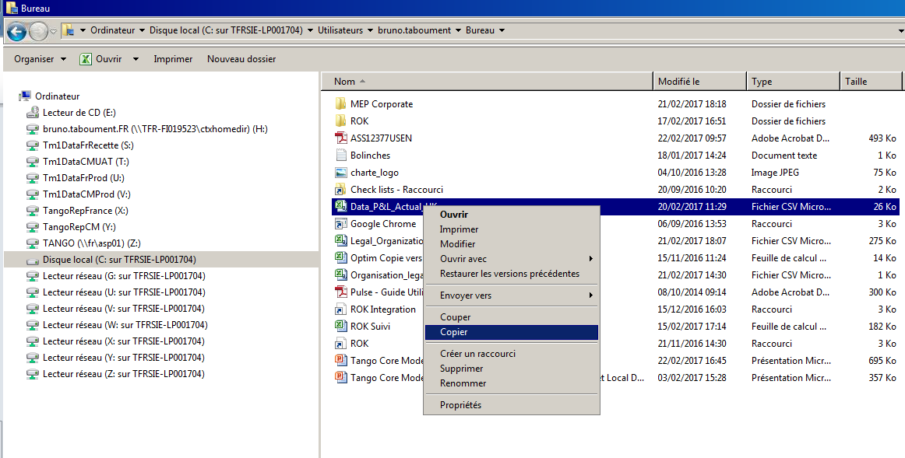

Step 4/6 : Select the source files
Select the source directory where the file to upload is stored using Citrix Explorer
Copy the file
Copy and paste a file from another Windows Explorer will not work.

Slide 7
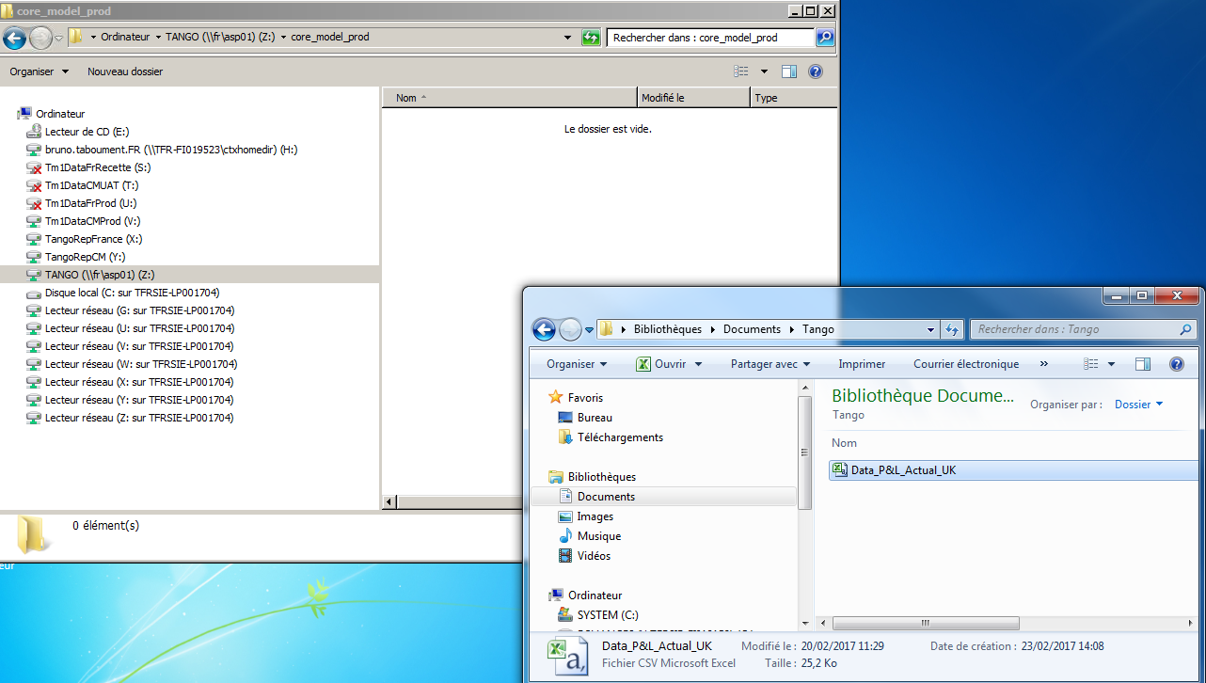


Step 4/6 : Select the source files
Copy and paste a file from another Windows Explorer will not work. You need to select the source files using the Citrix explorer

Slide 8
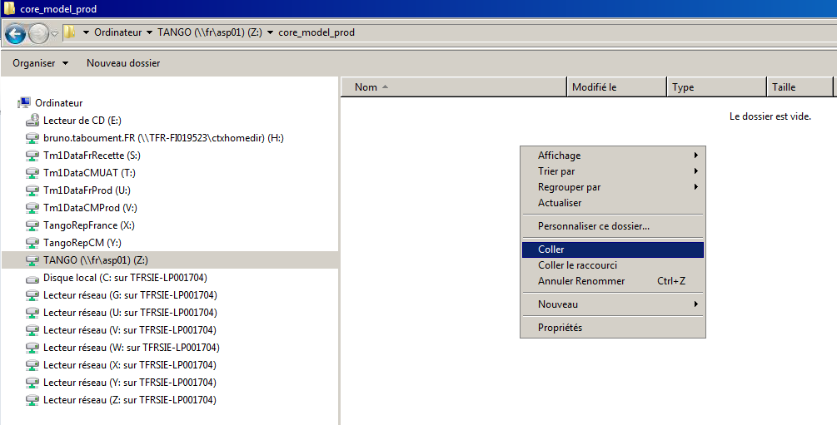
Step 5/6 : Paste the file selected into the target Tango directory
Select the target directory
Paste the file
Copy and paste a file from another Windows Explorer will not work.

Slide 9
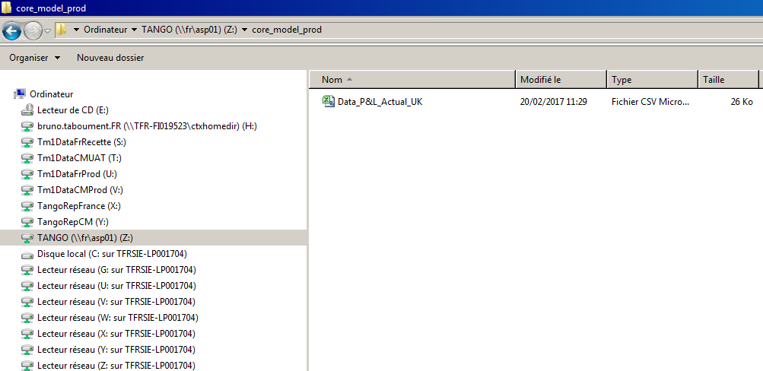
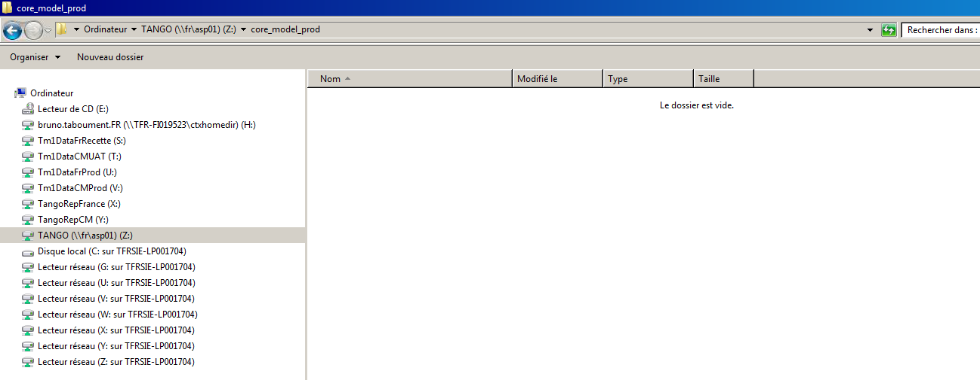
Step 6/6 : Use the server explorer to copy and paste your files
Paste the file
Once the file disapears, connect to Tango and upload the files
The file will be taken into account every 15 minutes

Slide 10


Any issue ?
Please contact the Tango Core Model support support.tangofrance@transdev.com

